Slide 1
Framing and Articulating Your Experience to Advance Your Career
Taylor Lynch, Career Services
August 2026

Slide 2
Introductions
Notes:
Depending on attendance, have everyone in attendance share: name, pronouns, department, and role

Slide 3
Background
Graduated from Cortland in 2017 with B.A. in Communication Studies
Assistant Director of Alumni Engagement from Oct. 2017 to June 2022
Internship and Student Employment Coordinator in Career Services from June 2022 to July 2025
Associate Director of Career Services from January 2025 to present
Notes:
Help to frame conversation
My educational background is in communications so I have a marketing brain and that frames the way I think about all of this

Slide 4
Why is framing and articulating your experience important?
Notes:
Discuss why folks are there today/what they hope to get out of the session
Why they think this conversation is important
Could give them the questions ahead of time in a form to fill out before we start and then share those answers out (MS Forms present) or use MS Whiteboard

Slide 5
Where do we articulate experience?
Tenure
Promotions / applying for new jobs
Grants / funding
Awards
Consider your audience: Different opportunities require different language and for experience to be framed in a way that makes sense for the intended audience
Notes:
Ask folks to share their answers before showing them list on the screen

Slide 6
Framing and using intentional language
Think about: Who is the intended audience and what is the language that would be most successful?
What is important for them to know?
How do we frame it in a context that makes sense for the audience?
Showing v. telling
Notes:
We are going to look at some examples

Slide 7
Don't undersell yourself
You can't expect others to know what you do – you have to articulate it
  References will not solely carry you
If you are applying for a new job or a promotion, chances are you won't always 100% meet their preferred qualifications – that is OK! You can still be confident in applying!
  There is always room for growth, but you have to at least show a track record of rising to challenges and be able to articulate your transferrable skills
Being able to articulate your skills and experience can be a great confidence builder!
  Allows you to work through/process all that you've done and experienced and start to believe that you are ready for the next step or are fully deserving of the award or scholarship
Notes:
Before we jump into an example (the language that we use in Career Services), we want to remind you of the following:

Slide 8
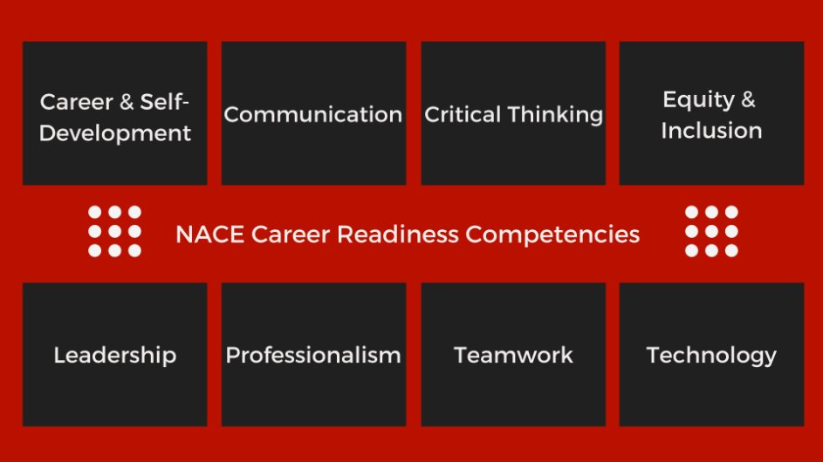
NACE Competencies
Studies by NACE show that employers are looking for applicants to be able to articulate at least the following 8 skills:
Notes:
Create MS Whiteboard where they can pick one of the 8 competencies and write an example of how they showcase this skill (bring actual sticky notes as a back up to do physical version)
Follow up question – Show of hands: How many of you teach students how to do these things (work as a team, communicate, think critically) in your classroom? – and ask them to give examples of this (also add to Whiteboard)

Slide 9
Examples
Resume and cover letter for Associate Director role (and resume/cover letter workshops)
SUNY Incremental Funding proposal
Award nomination for an office program
Notes:
Talk about how when applying for jobs, you want to make sure to take the job description and customize your resume and cover letter to match this role and show how you have the experience to be qualified/a good fit for the role. You don’t need to change every single thing, but using their language and making sure to touch on many parts of the job description to show yourself as a match is helpful.
When applying for funding for an upcoming program, I put together a proposal that was concise (3 pages) that contained: an overall summary of the program, rationale and need for this program, program logistics including a proposed cost/budget, program benefits, and plans for assessment. The language I used throughout linked it all back to work that supports the Life and Career Foundations pillar of the current university strategic plan.
Serving as the professional development chair for SUNYCDO, when we reviewed award nominations, the ones that were the strongest and stood out among the rest were able to answer the prompts on

Slide 10
Let's practice!
Notes:
Use the worksheet provided to practice how you will articulate something from your own life

Slide 11
This can help your students, too!
Show them the importance of what they are learning in your classes or programs you run and help them to articulate what they've experienced and learned
You've probably helped them to build so many important skills, but they have to be able to articulate them to count
How can they connect what they've learned in your class or your program to what they want to do in the future?
Notes:
We're going to practice this

Slide 12
Show the importance of what you do
Help students be able to share the impact that your teaching has had on them
If they can't articulate what they've learned, they can't share it and then the impact only goes so far
In conversations of ROI, this helps to showcase our programs' value
  If a student can say "My major classes through the English department helped me to build my communication, critical thinking, and teamwork skills by doing the following: XYZ" and showing how they built these skills, that is much more powerful than them just saying they like their major or their classes / programs they are a part of
Notes:
Before we practice this, we want to make sure you also understand the importance of this – outside of how it directly impacts the student individually, but also how it can strengthen our academic and extracurricular programs

Slide 13
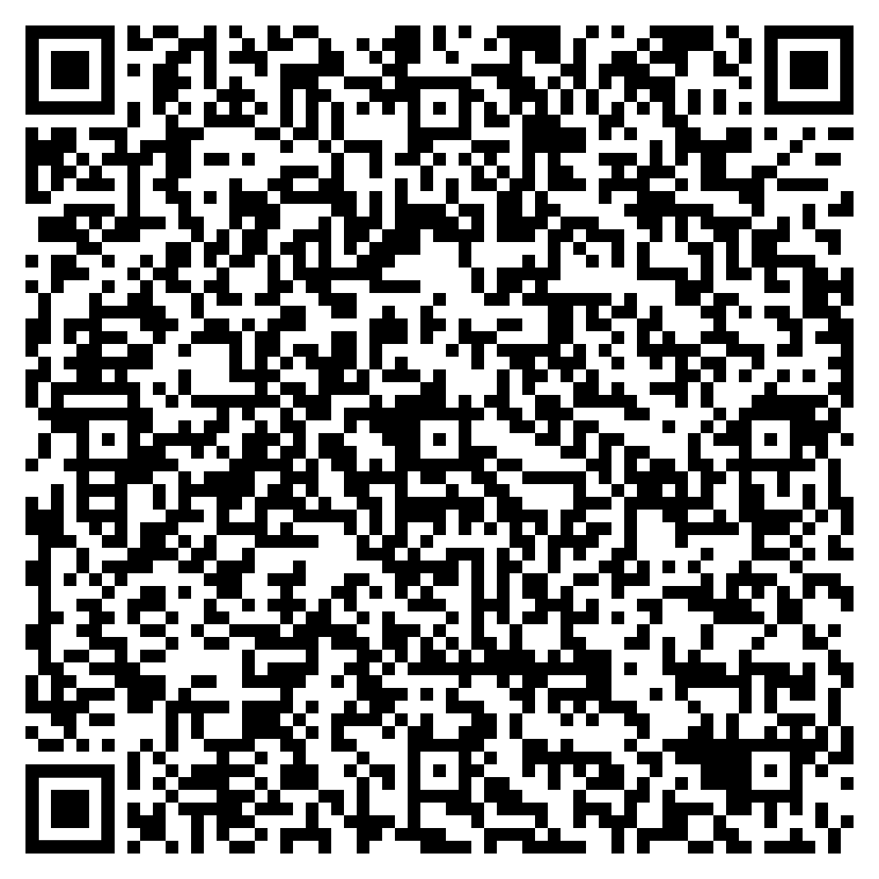
Let's practice again!
Notes:
Use the worksheet provided to articulate how you help students build these skills and then add some examples to the Whiteboard:
https://whiteboard.cloud.microsoft/me/whiteboards/p/c3BvOmh0dHBzOi8vY29ydGxhbmQtbXkuc2hhcmVwb2ludC5jb20vcGVyc29uYWwvdGF5bG9yX2x5bmNoX2NvcnRsYW5kX2VkdQ%3D%3D/b!VVPjOr6daESgnnpsm-uV_m41nu9snfRKq2_B0i-6Gvxq-M4-q9y3QrW0pEaEx-0N/01F66VUQOAVDUG3T5C2ZEYENOQ3XB2PMN6

Slide 14
Want to learn more?
Career Champions program coming soon
Piloting a Career Champions program this fall
Cohort meeting once a month throughout the semester to discuss best practices for integrating career readiness into your curriculum and supporting your students with their career development
$500 stipend for participating
If you are interested in participating in a future semester, please reach out and we will share more information on how to apply

Slide 15
Keep in touch!
Taylor Lynch '17
Associate Director of Career Services
taylor.lynch@cortland.edu
607-753-4715
Notes:
We are going to look at some examples

